Slide 1
A PPT on Data Wrangling & Data Acquisition
-By Suraj.G.Shejul

Slide 2

Data Wrangling and Data Acquisition
Explore the essential processes of transforming raw data into actionable insights. Learn effective techniques for sourcing, cleaning, and organizing data to power your data-driven projects.

Slide 3
Introduction to Data Wrangling
Data wrangling is the process of transforming and cleaning raw, messy data into a structured format that can be easily analyzed and used for decision-making. This critical step involves activities like data extraction, data cleaning, data integration, and data normalization.
Effective data wrangling helps organizations unlock valuable insights from their data, improve data quality, and make more informed, data-driven decisions.

Slide 4

Data Acquisition Techniques
Web Scraping: Extracting data from websites using automated scripts to gather large datasets across the internet.
API Integration: Connecting to external data sources through application programming interfaces (APIs) to access structured data programmatically.
Database Querying: Directly querying databases and data warehouses to retrieve relevant information for analysis.

Slide 5

Data Cleaning and Transformation
Data cleaning and transformation are crucial steps in the data wrangling process. This involves identifying and addressing data quality issues, converting data to a consistent format, and restructuring the data to enable further analysis.
Common data cleaning tasks include handling missing values, removing duplicates, and correcting formatting or typographical errors. Transformation may involve aggregating, filtering, or merging datasets to derive new insights.

Slide 6
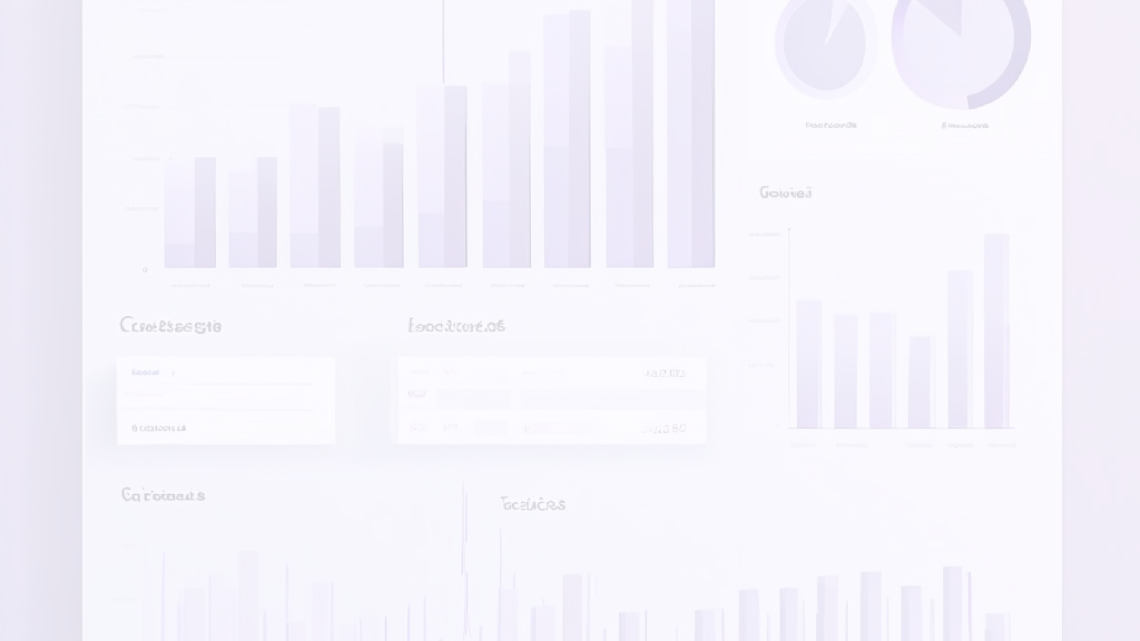
Handling Missing Data
Identify Missing Data
1
Examine your dataset thoroughly to identify any gaps or missing values. This is the crucial first step in addressing missing data.
2
Understand the Cause
Determine why the data is missing - was it due to an error, a limitation in data collection, or a systematic issue?
Choose an Appropriate Solution
3
Based on the cause, decide whether to impute the missing values, remove the affected rows/columns, or use more advanced techniques like interpolation.

Slide 7
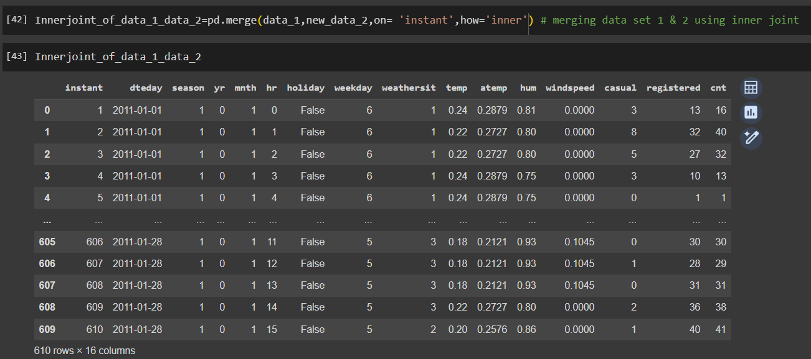
Merging and Joining Datasets
Merging and joining datasets is a crucial step in data wrangling, allowing you to combine information from multiple sources. This enables a more comprehensive understanding of the data and supports more robust analyses.
Effective techniques include inner joins, outer joins, and union operations, each with their own benefits and use cases. Careful data preparation and clear definitions of the join keys are essential to ensure accurate results.

Slide 8
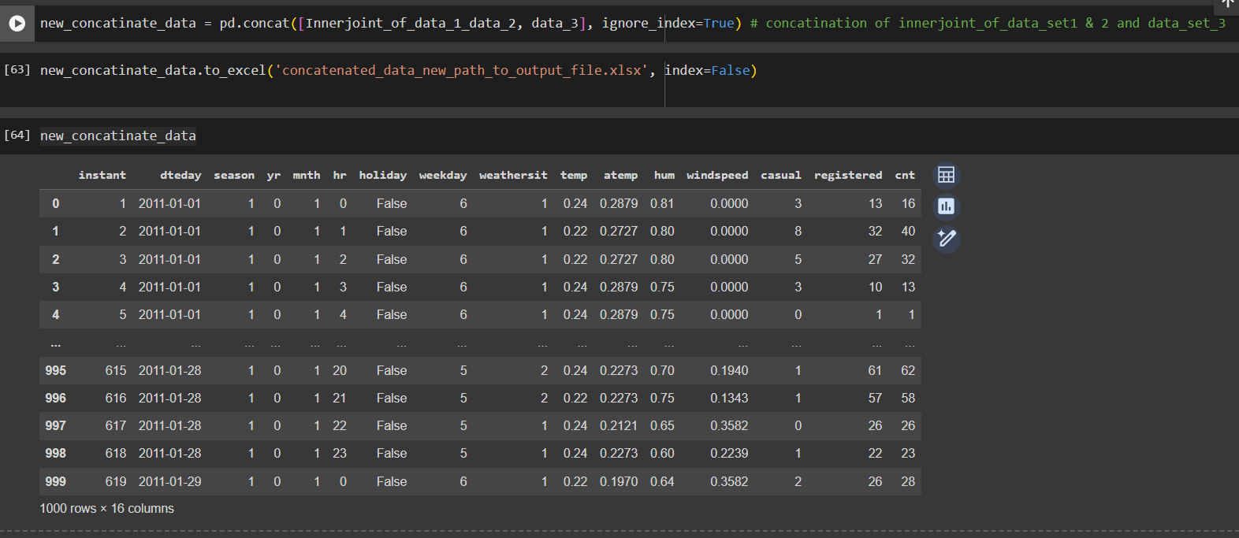
Concatenation of Data Sets
1
Combining Multiple Datasets
2
Preserving Data Structure
Concatenation is the process of combining multiple datasets into a single unified dataset. This allows you to analyze a more comprehensive set of data.
Concatenation maintains the structure and schema of the original datasets, ensuring the integrity of the combined data.
3
Expanding Analysis Capabilities
4
Streamlining Data Workflows
By concatenating datasets, you can expand the breadth and depth of your data analysis, uncovering new insights and trends.
Concatenation helps streamline data management by eliminating the need to constantly switch between multiple datasets.

Slide 9
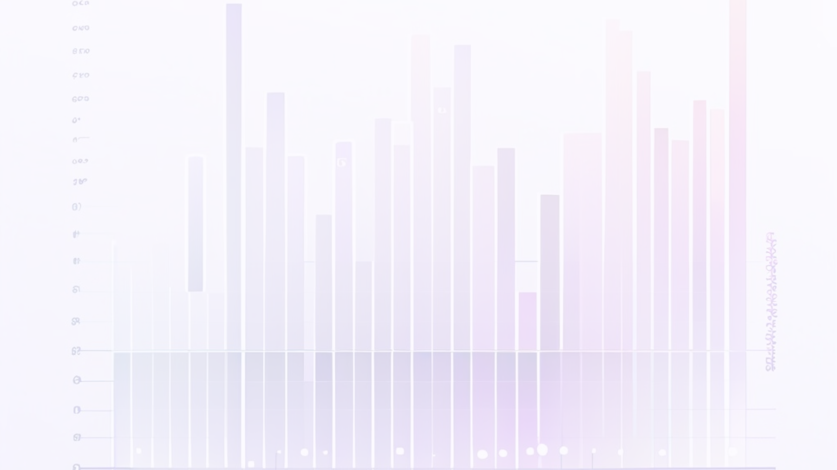



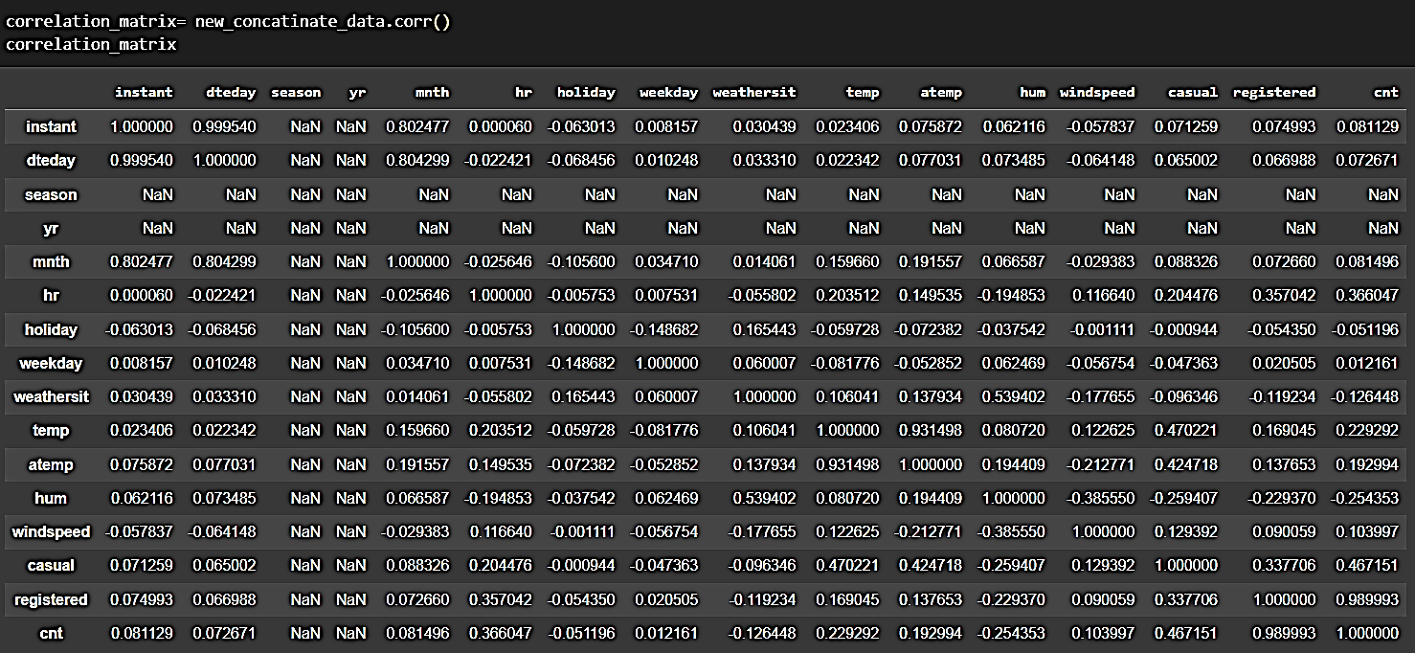
Determining the Correlation of the Dataset
Identify Variables
Calculate Correlation
Visualize Correlations
Determine the key variables in the dataset that you want to analyze for correlation.
Use statistical techniques like Pearson's correlation coefficient to measure the strength and direction of the relationship between variables.
Create a correlation matrix or heatmap to clearly display the correlation coefficients between all variables.

Slide 10
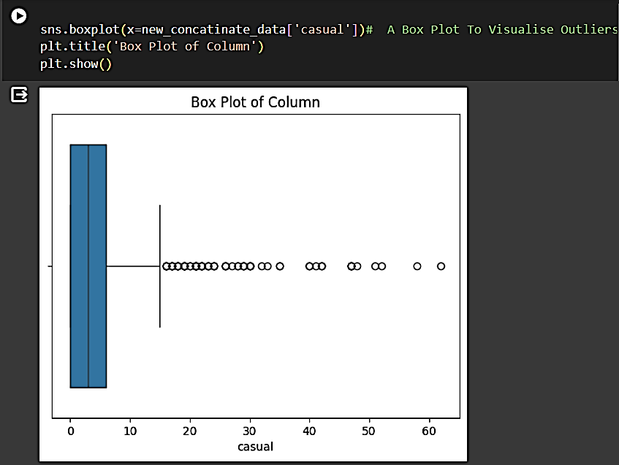
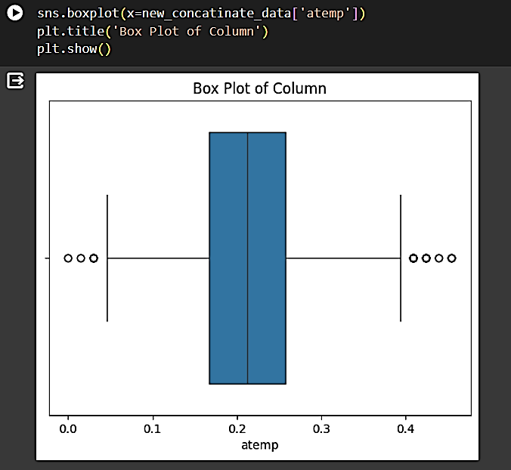
Box plots for the Related project

Slide 11
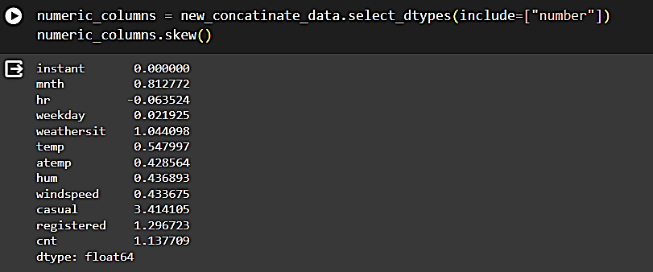
Understanding Skewness in Data
Definition of Skewness:
Skewness is a measure of the asymmetry of the distribution of data points in a dataset.
It indicates whether the data is skewed to the left or right, or if it's approximately symmetric.
Interpreting Skewness:
A skewness value of 0 indicates a perfectly symmetrical distribution.
Negative skewness (left-skewed) indicates that the tail of the distribution is longer on the left side.
Positive skewness (right-skewed) indicates that the tail of the distribution is longer on the right side.
Effects of Skewness:
Skewness affects the mean, median, and mode differently:
In a positively skewed distribution, the mean is typically greater than the median, which is greater than the mode.
In a negatively skewed distribution, the mean is typically less than the median, which is less than the mode.
Understanding skewness helps in assessing the shape and characteristics of the dataset.
Calculating Skewness:
Skewness can be calculated using statistical formulas or software tools.
Common methods include computing the third standardized moment or using statistical libraries in programming languages like Python.
Example:
[Insert an example dataset and visualize its distribution to illustrate skewness.]
Conclusion:
Skewness provides valuable insights into the distribution of data and helps in making informed decisions in data analysis and modeling.
Slide Design:
Use visuals such as histograms or density plots to illustrate different skewness scenarios.
Choose a color scheme that complements the content and enhances readability.

Slide 12
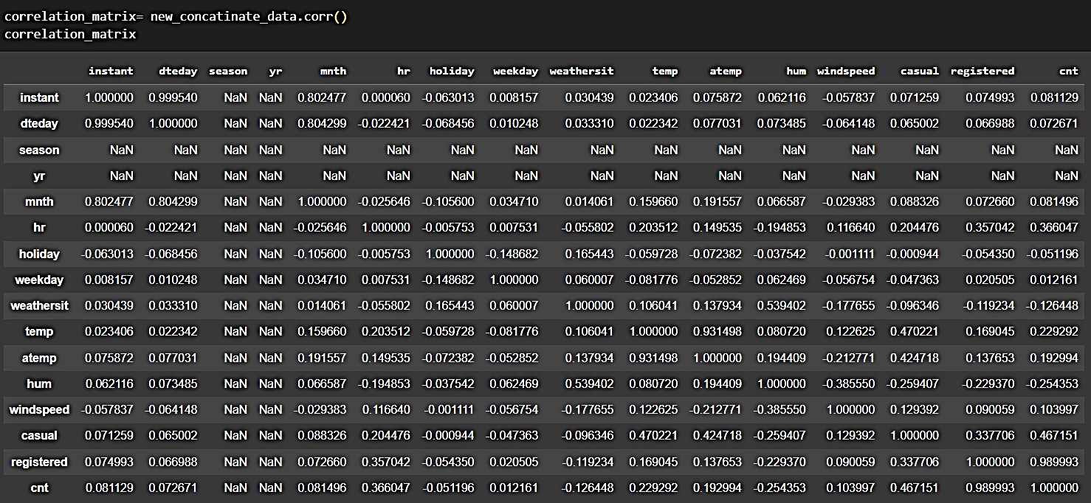
Co-Relation in data
Correlation measures the strength and direction of the relationship between two variables in a dataset.
It quantifies how changes in one variable are associated with changes in another variable.
Interpreting Correlation Coefficients:
Correlation coefficients range from -1 to 1:
1 indicates a perfect positive correlation.
-1 indicates a perfect negative correlation.
0 indicates no linear correlation.
The closer the correlation coefficient is to 1 or -1, the stronger the correlation.
A correlation coefficient of 0 doesn't necessarily mean no relationship; it indicates no linear relationship.

Slide 13



Generating The Heat Map of the Data
Identify Variables
1
Determine the key variables to be included in the heat map analysis.
Compute Correlations
2
Calculate the correlation coefficients between all pairs of variables.
Visualize Relationships
3
Represent the correlation matrix as a heat map to visually showcase the strength and direction of relationships.
The heat map provides a powerful way to quickly identify patterns and correlations within a dataset. By computing the correlation coefficients between all variables and displaying them in a visual grid, we can uncover hidden insights and relationships that may not be obvious from the raw data alone.

Slide 14

Conclusion of Data Wrangling and Acquisition
Data wrangling and acquisition are essential stages in the data analysis process. By cleaning, transforming, and combining datasets, analysts can unlock valuable insights and make informed decisions.
With a robust data foundation in place, organizations can move forward with advanced analytics and data-driven strategies to drive business success.

